Slide 1
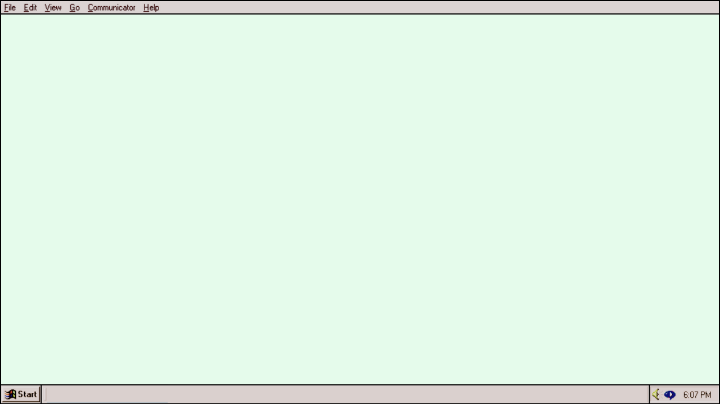
L’Archivage web
BiblioTECH 2023
Hélène Brousseau / Bibliothécaire, ressources visuelles et médias numériques, Université Concordia
Sarah Lake / Bibliothécaire, préservation numérique, Université Concordia
Notes:
Welcome/intros
Sarah: web archiving is one aspect of my job, I lead the library’s web archiving efforts; help my colleagues preserve web content and I give workshops on web archiving for Concordia grad students and faculty.
Hélène Brousseau is the digital media and visual resources librarian at Concordia University, formally the digital collections and systems librarian at Artexte where she lead Artexte’s Web archiving initiatives which include introductory workshops using Webrecorder and Conifer.
This is a beginner-level workshop, more practical-oriented than technical-oriented
Goal of workshop: to introduce you to the practice of web archiving; mention some things to think about as you plan to archive web content; and show you a free tool to preserve web content on a small scale

Slide 2
Qu'est-ce que l'archivage web ?
L'archivage du Web est un processus qui consiste à rassembler des parties du Web, à préserver les collections dans un format d'archivage, puis à diffuser les archives à des fins d'accès et d'utilisation.
https://netpreserve.org/
Notes:
So what exactly is web archiving?
IIPC defines web archiving as “”
so an ex of WA that you might be familiar with is the wayback machine.
Wayback is the platform by which you can access the IA’s vast collection of archived web pages (archiving the web since 1996, over 800 billion web pages in their archive), you can travel back through time and see what a web page looked like 10, 20 years ago
so the wayback machine is one famous example of WA. when we’re talking about WA this can be as simple as taking a snapshot of a webpage at a certain point in time, or as complex as creating a fully interactive copy of an entire website with all of its functionality preserved; and there’s a lot of different tools that allow you to do this, out they that all work a bit differently.
so the important thing to note here is that there’s really a spectrum of complexity in web archiving, depending on what your goal is and what exactly you’re trying to capture.

Slide 3
L’Archivage web dans les bibliothèques
Un nombre croissant d'institutions du GLAM s'engagent dans l'archivage du web :
Bibliothèques nationales (LAC-BaC, BAnQ)
Projets collectifs (SUCHO, CARTA)
Bibliothèques universitaires (Concordia, McGill)
Les outils et plateformes d'archivage sur le web sont de plus en plus répandus et accessibles :
Archive-It, une plateforme hébergée populaire
Des outils ouverts comme Webrecorder permettent également d’archiver soi-même
Notes:
web archiving in libraries: preserving and providing access to information; cultural heritage
There’s also collaborative WA projects:
SUCHO: a network of volunteer web archivists that formed at the start of the war, who collaborated to archive Ukranian websites before they went offline.
https://www.sucho.org/
CARTA: a consortium of art libraries that was formed to build an archive of web content related to art history and contemporary art practice.
participating Canadian institutions include AGO, National Gallery for example
https://carta.archive-it.org/

Slide 4


Outils d'archivage web dans les bibliothèques
CAPTURE AUTOMATISÉE
À L’AIDE DE ROBOTS
(e.g. Archive-It)
Contenu téléchargé automatiquement par les robots d'indexation par le biais de requêtes HTTP
Modulable
Limitations pour le contenu dynamique
PILOTÉ PAR L'UTILISATEUR
DYNAMIQUE
(e.g. Webrecorder)
Contenu téléchargé au fur et à mesure de son chargement dans le navigateur : nécessite une interaction par l'utilisateur
Processus manuel (qui prend du temps)
Idéal pour le contenu dynamique
Notes:
(pause for questions)
Many, many web archiving tools to choose from
I won’t attempt to try to explain them all, but I’ll speak instead more broadly about two approaches, and talk about the advantages and disadvantages of each: these two approaches are crawler driven and user-driven (I should note that these are not really official terms, in that you won’t find an authoritative definition for them anywhere, but I have seen them used in an informal way in web archiving literature to describe these approaches, and I personally find them helpful. I just wanted to mention that in case you were wondering where these terms came from)
So an example of a crawler-driven web archiving tool would be archive-it. The way this kind of tool works is that the web archivist come up with a list of seeds (URLs that you want to capture), you set the parameters for the seeds e.g., do you want every link on the page to also be captured, etc, and then once everything is set up: you start a crawl, and the web crawlers automatically do all the work of downloading all the code, images, documents, and other files from that URL, whatever is essential to reproducing the content as similarly to original form as possible. And this is completely hands off–you come back in a few hours or a couple days and you review what the crawlers captured. So this is great for web collections with a lot of content, it’s very scalable.
The disadvantage to this approach is that even for a pretty experienced web archivist, it can take a lot of trial and error and troubleshooting to figure out why certain parts of a website or web page weren’t captured by the crawlers. Also, when it comes to what we call dynamic content, meaning any content that requires user interaction to load, like a video that you need to click play on, or if you think of instagram, where as you scroll, more content loads–web crawlers typically really struggle to capture that content because they can’t interact with a website the same way a user can.
So this is where user-driven or dynamic capture methods come in: the tool we’ll be showing you today, webrecorder, is an example of this. What we mean by user driven is that the capture process depends on active participation from a user. Rather than a web crawler going to just fetch content from a url in an automated way, what’s happening is the content that’s loading in your browser is being intercepted by the web archiving server, which is capturing exactly what you’re seeing in your browser during your session. So what’s great about these kinds of tools is that they’re really great at capturing dynamic content, because you are providing the interaction that it needs to capture that, by for example, clicking play on a video. Of course, the disadvantage is that it’s completely manual, so capturing an entire website, even a pretty small one, is quite time-consuming.

Slide 5
Webrecorder

Slide 6
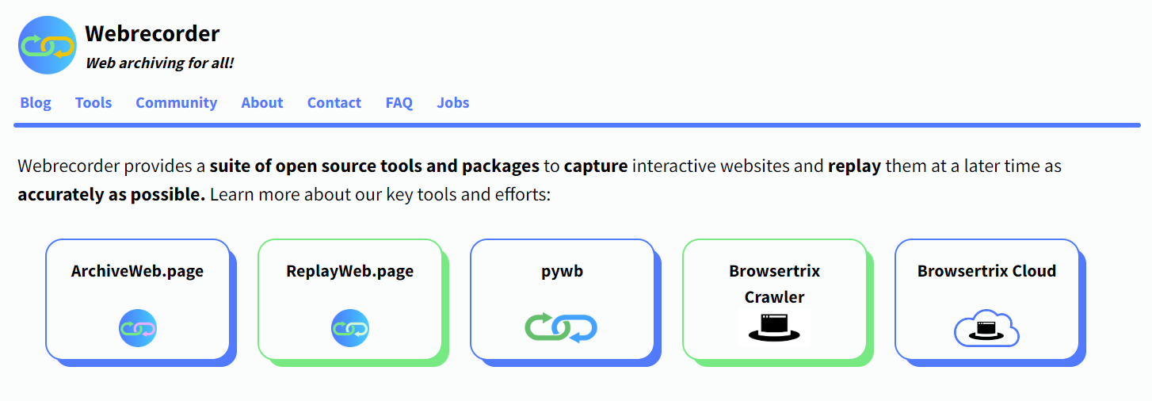
https://webrecorder.net/
Notes:
Webrecorder is a community-run software project that develops open-source tools to capture websites and replay them.
So we’re going to be talking about two webrecorder tools today: archiveweb.page and replayweb.page. (as the names suggest, the first one captures web content and the second one replays the captured content)
https://webrecorder.net/

Slide 7

Webrecorder : historique
2014 : créé par le développeur indépendant Ilya Kreymer
2015-2020 : Partenariat pluriannuel avec Rhizome dans le cadre de la bourse Mellon
2020 : Webrecorder est désormais un projet communautaire indépendant
Notes:
A bit of history: the webrecorder software was originally created in 2014 by an independent developer named ilya kreymer. From 2015-2020 they partnered with Rhizome with support from a Mellon Foundation grant to further develop the software. If anyone is unfamiliar with Rhizome, they’re a non-profit dedicated to promoting and preserving digital art, and they’re affiliated with the New Museum of Contemporary Art in New York City
As of 2020, webrecorder is now an independent project again.
I’ll also mention that the capture tool that we’ll be using today, archiveweb.page is available as both a desktop app and a browser extension: for the demo we’ll be focusing mostly on the desktop application; the capture process is very similar for both.
so we’re going to show you how it works: I’m going to walk through the interface and the features with screenshots on the next few slides, and then H. will do a live demo and show you everything a second time. and at that point, you can follow along if you’d like on your own computer. but we’ll also give you some time after the demo to try it out yourself.
(if anyone would like a couple minutes to download archiveweb.page, please raise your hand)
link to download: https://github.com/webrecorder/archiveweb.page/releases
paste in chat: (choose .exe for windows or .dmg for mac)

Slide 8
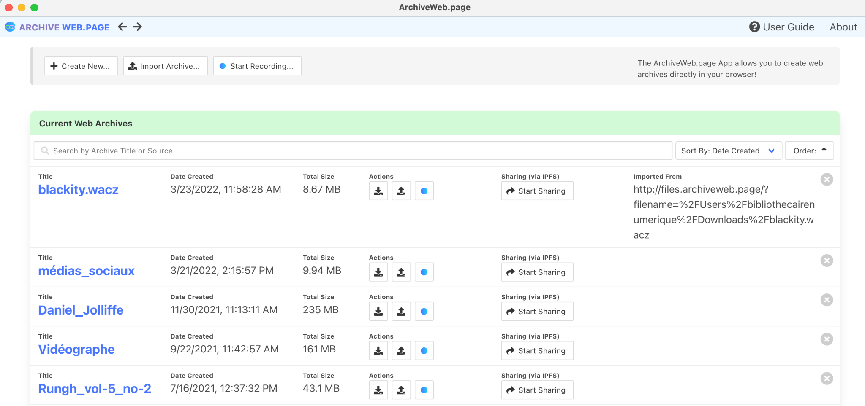
DÉMONSTRATION DE WEBRECORDER, 1ʳᵉ OPTION : L'APPLICATION
Cliquez sur le bouton bleu pour archiver des pages web dans une collection existante
Cliquez ici pour créer une nouvelle collection
https://webrecorder.net/
Notes:
When you open the app, you will see all your collections under “current web archives”
you can see high-level information about your collections: date created, size, etc
You can create a new one at the top left
Or add to an existing collection using the blue button

Slide 9
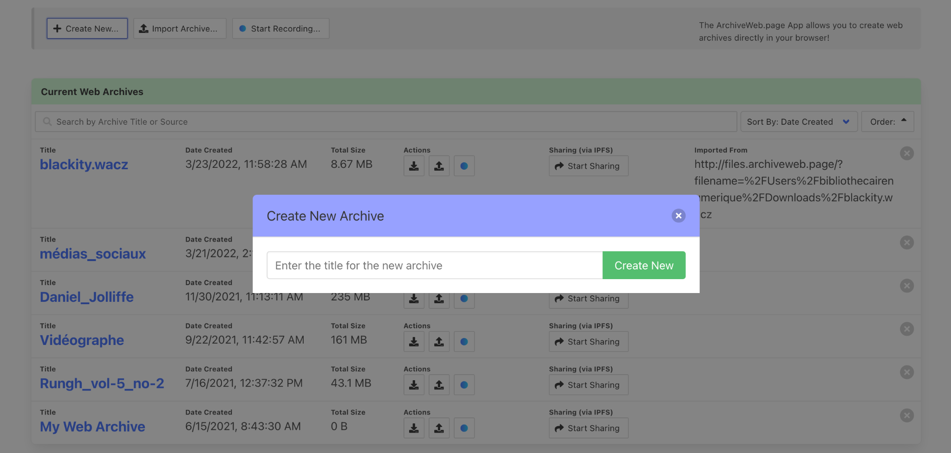
DÉMONSTRATION DE WEBRECORDER, 1ʳᵉ OPTION : L'APPLICATION
Donnez un titre à la nouvelle collection.

Slide 10
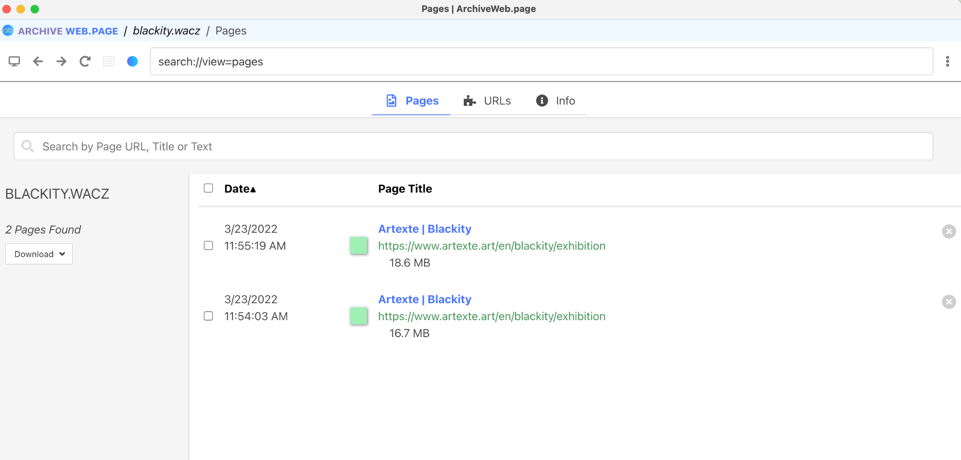
DÉMONSTRATION DE WEBRECORDER, 1ʳᵉ OPTION : L'APPLICATION
Cliquez sur le bouton bleu pour commencer une nouvelle capture dans la collection.
Notes:
if you go into an existing collection,
you’ll have a list of pages you have captured, with the size of the page, and the date captured
If you want to start a new capture in that collection, click on the blue button

Slide 11
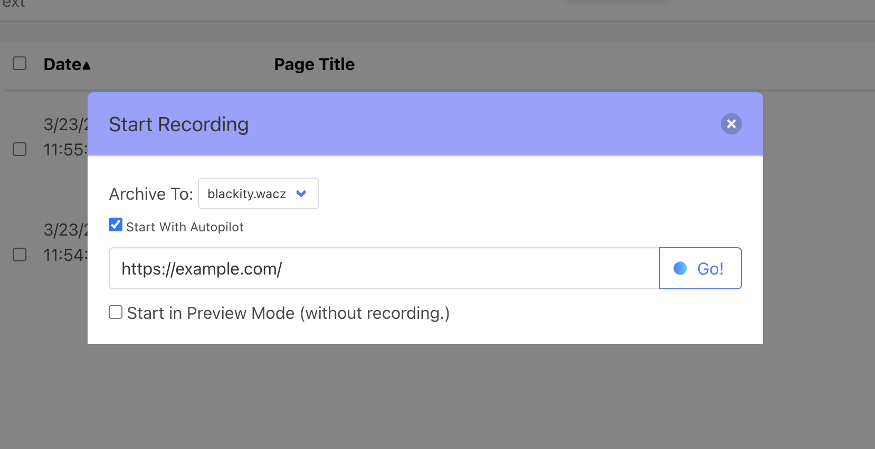
DÉMONSTRATION DE WEBRECORDER, 1ʳᵉ OPTION : L'APPLICATION
Cliquez sur "Go" pour lancer la capture.
Écrivez l'URL à capturer.
Notes:
A new window will pop up, where you can put the URL to capture
click go

Slide 12
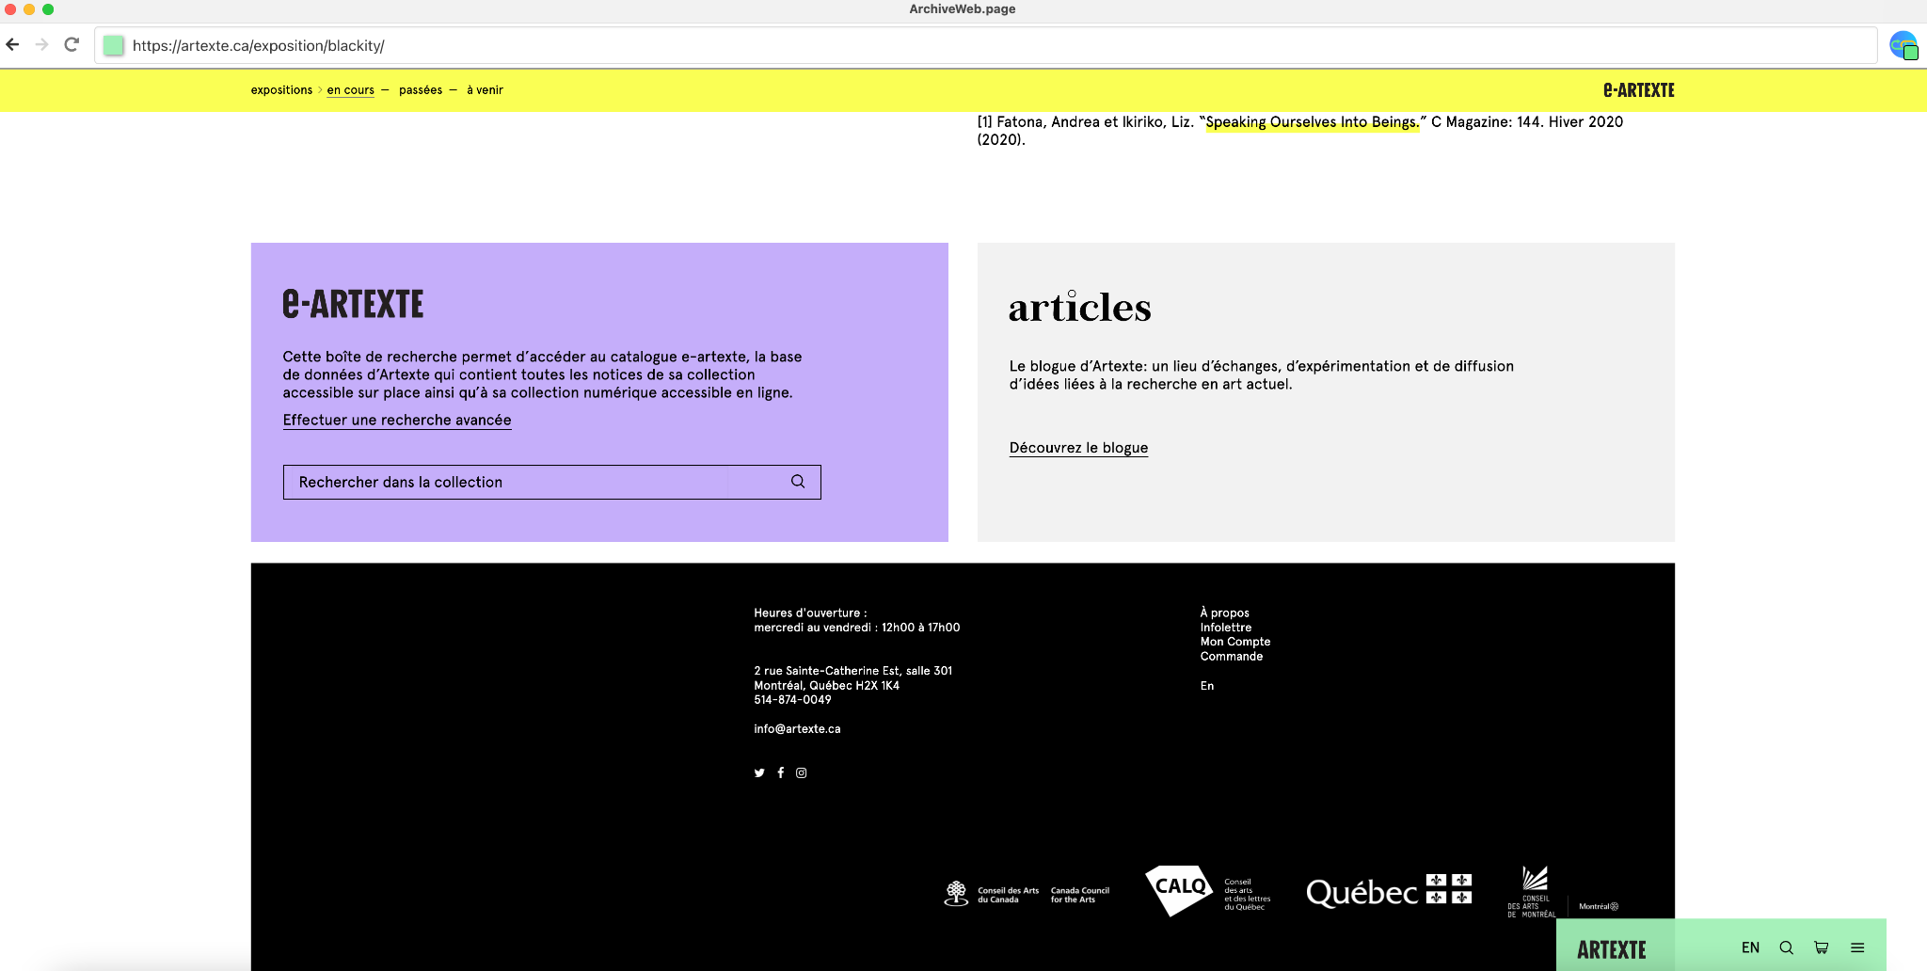
DÉMONSTRATION DE WEBRECORDER, 1ʳᵉ OPTION : L'APPLICATION
Le pilote automatique est généralement activé. La case change de couleur en fonction de son état :
brun avec un numéro : capture en cours
vert : la capture est terminée pour cette page
Vous devez naviguer et interagir avec la page. Veillez à cliquer sur toutes les images, tous les liens et tous les contenus audiovisuels que vous souhaitez capturer. L'outil d'archivage capturera toutes les informations qui entrent dans le navigateur web. Dans certains cas, une interaction est nécessaire pour que les informations soient reçues.
Notes:
by default, the capture will start with the autopilot feature on: this little indicator at the top right corner tells you the progress of the capture.
brown with number: capture in progress
green: the capture is completed for the page.
what’s happening is that app is copying all the content that’s loading in the browser as you’re viewing it: sometimes you need to interact with the page for something to load, for example clicking play on a video
you need to interact with the page; click on images, links, audiovisual content, to make sure everything gets saved

Slide 13
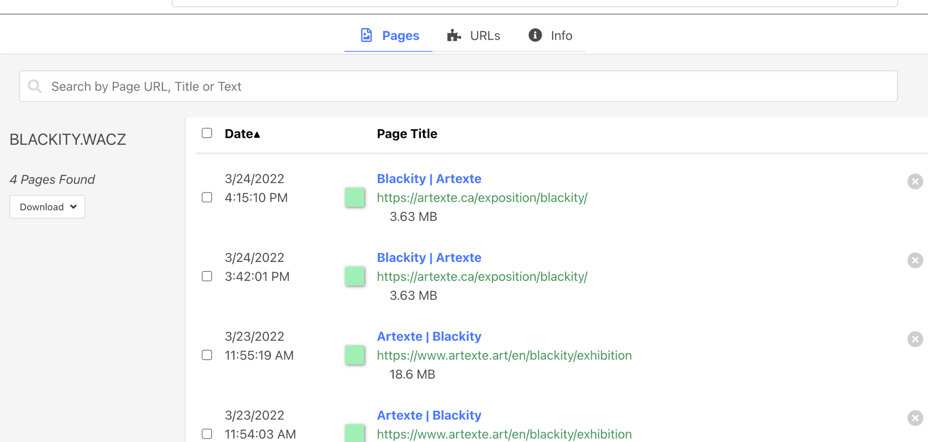
DÉMONSTRATION DE WEBRECORDER, 1ʳᵉ OPTION : L'APPLICATION
Vue de la collection d'archives web, après la capture.
Notes:
after you’re done, you can review what you captured:
on your collection page, you will see the URLs of all the webpages you archived during your capture session, along with the timestamp and amount of data captured
it’s also possible to delete a URL if you accidentally captured something you didn’t want included.

Slide 14
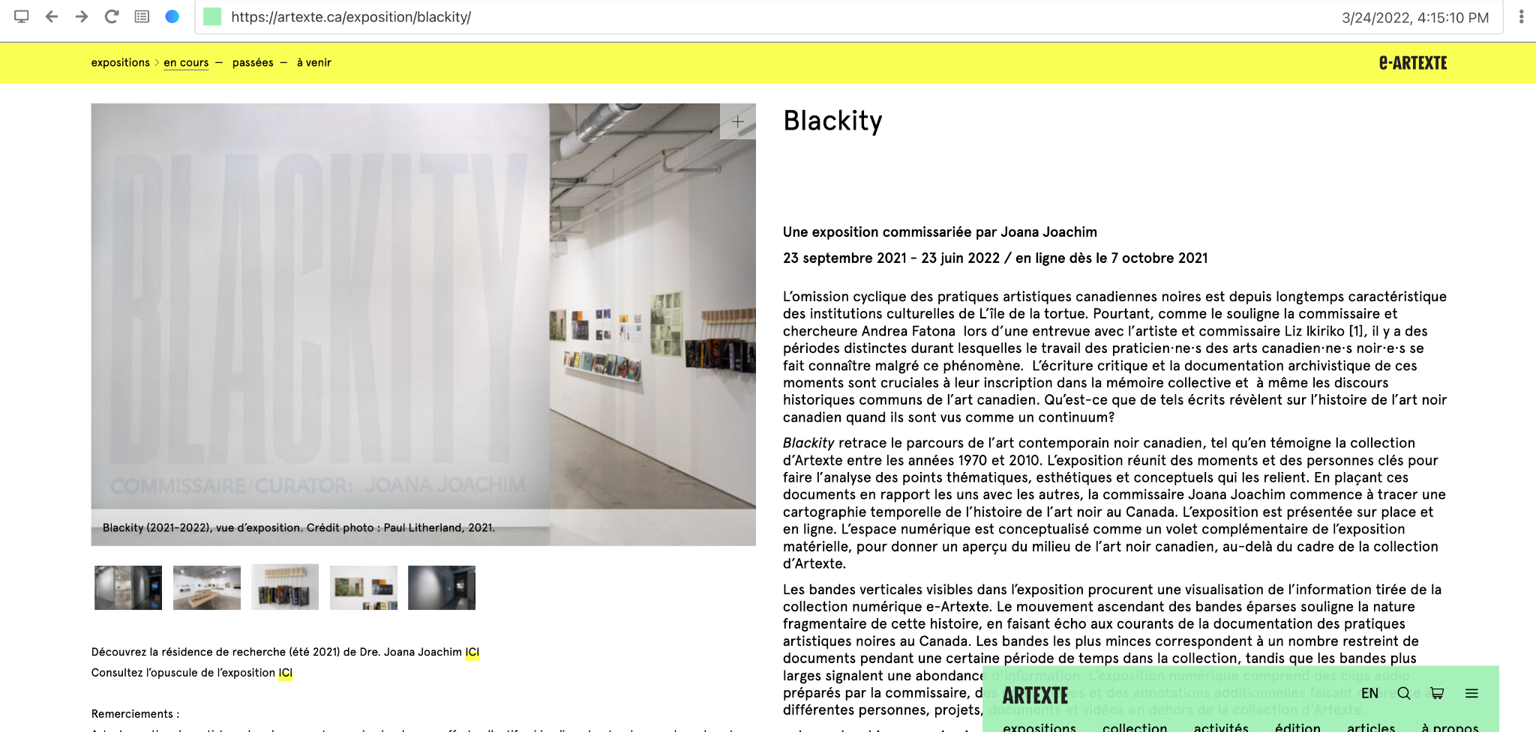
DÉMONSTRATION DE WEBRECORDER, 1ʳᵉ OPTION : L'APPLICATION
Vue lors de la consultation de l'archive web à partir du logiciel.
Notez que nous voyons la date et l'heure de la capture.
Notes:
you can play back your capture to review it, to make sure everything is loading properly.

Slide 15
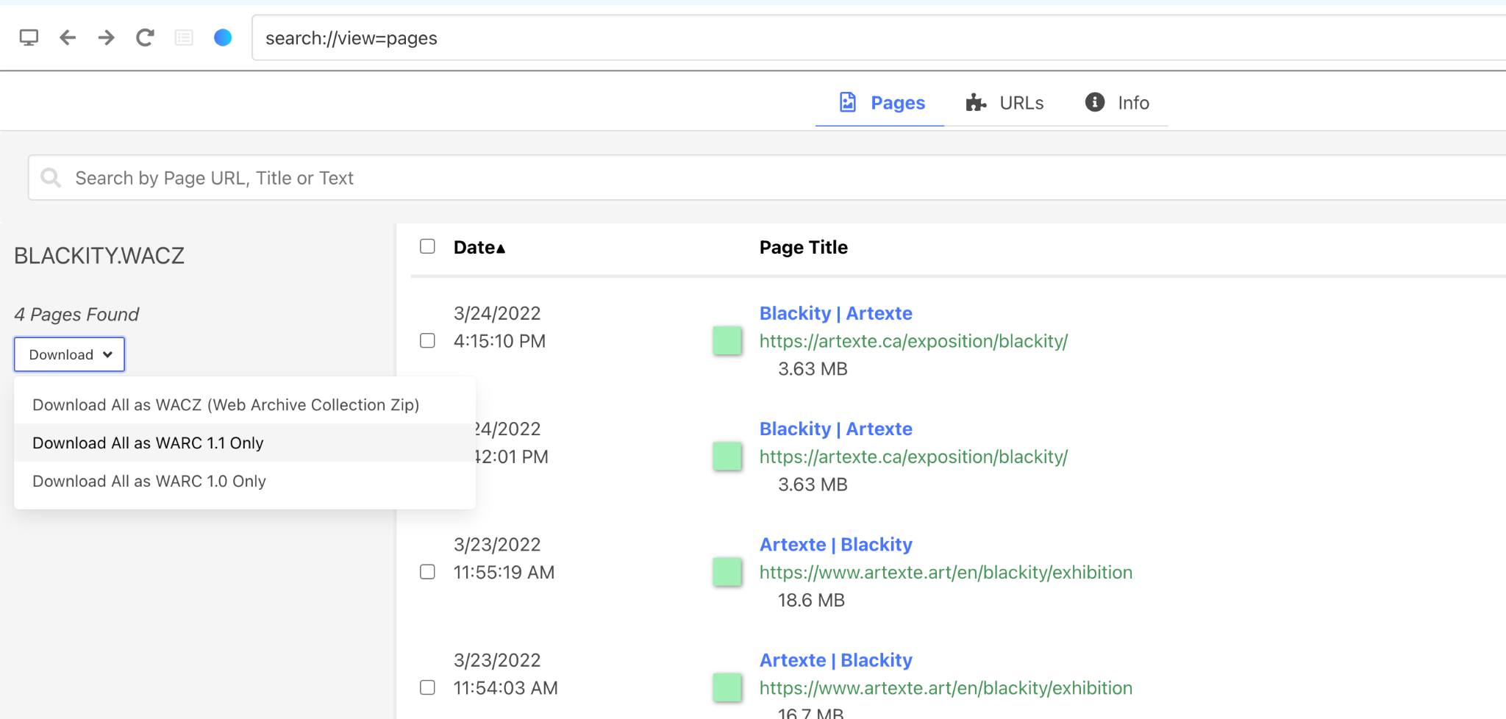
DÉMONSTRATION DE WEBRECORDER, 1ʳᵉ OPTION : L'APPLICATION
Notes:
a few options for downloading or sharing your captured content:
you can download a warc file, which is the pretty much standard file format for web archives
a warc will contain all of the data that was saved from your capture; so all of the html, all the code, all the images, all the elements that were harvested form the webpage, all packaged into one file.
it also contains important metadata like the date and time of the capture, and the tool used
you can also download a WACZ file, which is a zipped version of WARC, it s a newer more efficient specification
so what do you do with this warc file?
and then you can save multiple copies on cloud storage for safekeeping; if you’d like to share it with someone you can just give them a copy of the WARC file, they don’t have to download this application, all they have to do is load it into their browser using replayweb.page, which we will show you in a moment.

Slide 16
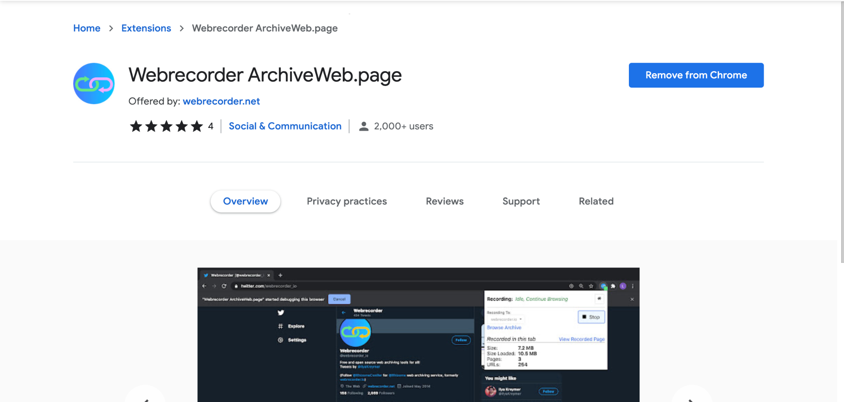
DÉMONSTRATION DE WEBRECORDER, 2ÈME OPTION : EXTENSION DE NAVIGATEUR
Notes:
so that’s the desktop app
there’s also the browser extension option, which we won’t demo, but it’s good to be aware of:
it essentially works the same way as the desktop: rather than storing the captured content on your computer, it stores it temporarily in your browser–once you’re done capturing, you can download a warc file and save it.

Slide 17
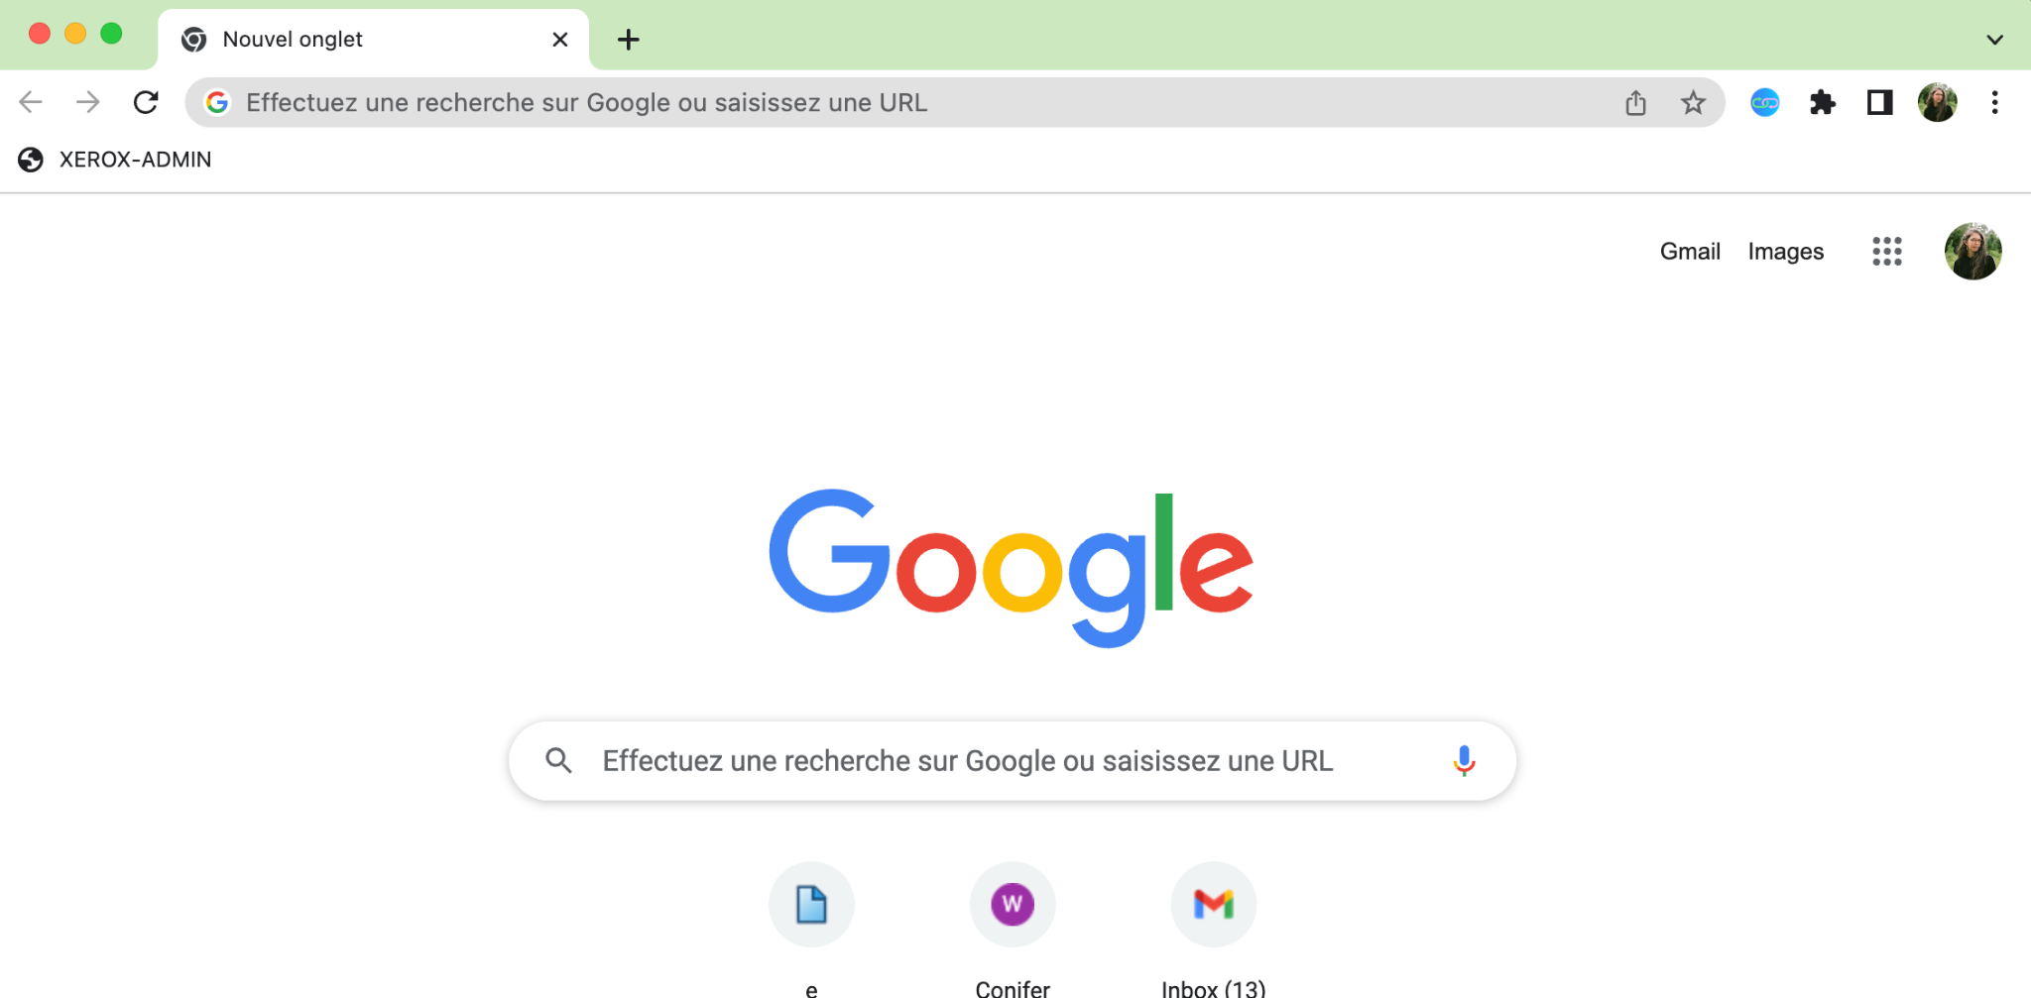
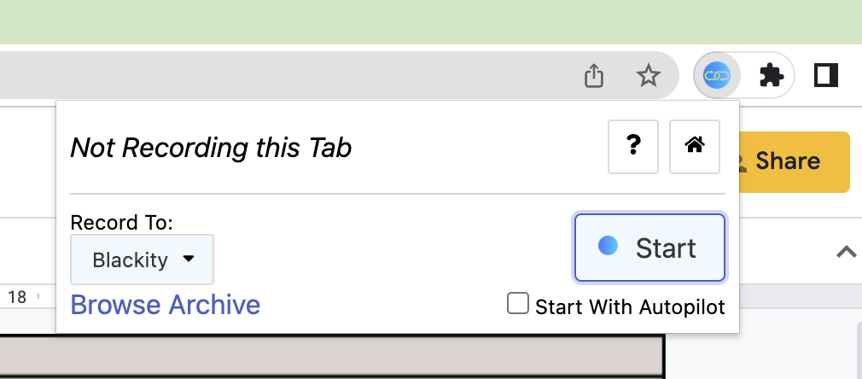
DÉMONSTRATION DE WEBRECORDER, 2ÈME OPTION : EXTENSION DE NAVIGATEUR
Cliquez sur l'icône de l'extension pour démarrer une capture web.
Un menu s'ouvre dans lequel il est possible de cliquer sur Démarrer pour commencer la capture.
Notes:
just to show you what it looks like: just open your browser and to the URL that you want to capture, and click on the extension and click start. so really simple

Slide 18
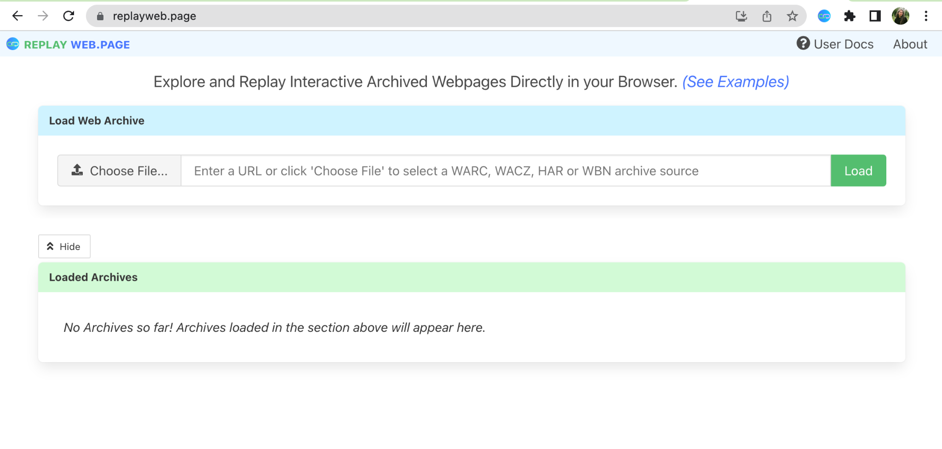
Consulter les fichier d’archive web
ReplayWeb.Page
Outil de consultation des fichiers d'archives web, y compris les fichiers de type WARC, WACZ, HAR ou WBN.
https://replayweb.page/
Notes:
https://replayweb.page/

Slide 19
Webrecorder démo

Slide 20
PRATIQUE
Capturez plusieurs pages web de votre choix à l'aide de Webrecorder et examinez votre capture.
Utilisez le chat ou ouvrez votre micro pour parler ou poser des questions !

Slide 21
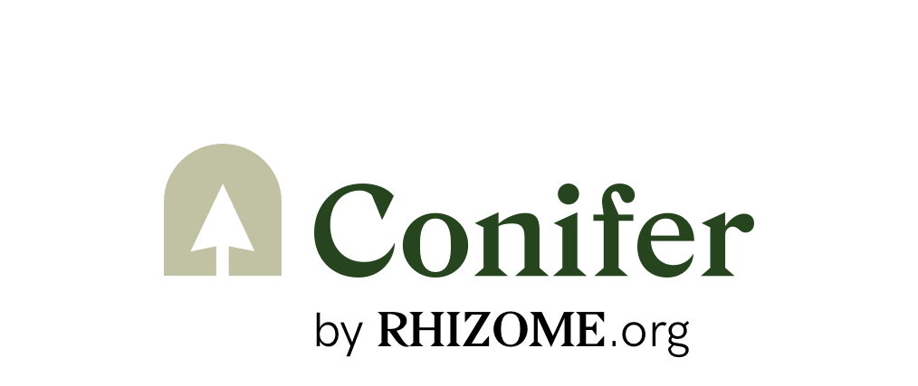
Plus d'outils d'archivage web
Conifer
Même type de logiciel de capture que Webrecorder, proposé en tant que service avec la possibilité d'héberger des collections.
Les comptes gratuits hébergent jusqu'à 5 Go
https://conifer.rhizome.org/
Notes:
earlier I gave some history about webrecorder: when the Mellon grant project ended, Rhizome actually rebranded parts of the software as a web archives hosting service, and they renamed it Conifer.
Conifer has a free tier which allows you to host up to 5 GB of content; and a supporter tier (current prices are 20 USD per month or 200 per year for 40 Gb of space)
Good option if you want to make your web archives easily accessible: anyone with the link can view them (no need to upload them to replay.webpage), and option to add descriptive metadata, etc.
https://conifer.rhizome.org/

Slide 22
Plus d’outils d’archivage web
youtube-dl : Programme de ligne de commande pour télécharger des vidéos à partir de YouTube.com et d'autres sites vidéo
“Save Page Now” feature: ajouter une page web à la WayBack Machine de l'Internet Archive
Documenting the Now: outils d'archivage pour les médias sociaux
Et plus encore!
https://netpreserve.org/web-archiving/tools-and-software/
Notes:
https://github.com/ytdl-org
http://web.archive.org/
https://www.docnow.io/
https://netpreserve.org/web-archiving/tools-and-software/

Slide 23
Merci!
helene.brousseau@concordia.ca
sarah.lake@concordia.ca

Slide 24
Enjeux éthiques et réflexions autour des archives web
Notes:
Though the web has significantly augmented our capacity to disseminate information and share stories. It remains a fragile space where content is constantly at risk of disappearing. In most cases it can start happening in the space of a few years. In this context, there are many question that we must ask ourselves on preservation: who’s stories are being archived and who has power in this process?
Traditional archives have been associated with long histories and a traditions of state power. And under the cover of objectivity and truth, archives and archivists have played an active role in giving space to certain voices all the while obscuring others.
The tool we are introducing you today allows for anyone to archive web content with very few limitations, but this process still involves many ethical issues that we encourage you to take into consideration when doing web archiving.
In the next few slides, we will briefly explore some of the issues that you might be confronted with.

Slide 25
Enjeux éthiques : éléments de réflexion
Droit d’auteur
Le site web contient-il des œuvres pour lesquelles vous n'avez pas l'autorisation de les diffuser à perpétuité ?
Dans quel contexte les archives seront-elles accessibles ?
Envisagez d'inclure une clause relative à l'archivage du site web dans les contrats conclus avec vos collaborateurs et de mettre en place des mécanismes de retrait de vos archives web.
Notes:
The first issue is a well known one: copyright
You should consider copyright whenever you are archiving Websites that include content that is not yours. As an individual this may be easy to navigate, however if you are creating web archives for an organizational website or for a research group, you should tread carefully.
For example, you produced an online exhibition that includes images. After the exhibition, you can no longer host the website, for whatever reason, and you want to use Webrecorder to archive the exhibition. If all the photographs you featured were in the public domain, then you don’t have to worry about it. But if you had to seek permissions from copyright holders to display those photographs in exhibition, you’ll probably want to make sure that they’re okay with their work being available online in perpetuity, not just for a set amount of time.
Another important element to consider, is how this content will be made available? Will it continue to be available online as an archival version of the exhibition, or will it be an offline copy of the warc file, that’s accessible only on a local computer through a warc player like replay.webpage? And do researchers need to sign an access agreement to view it?
If you have an archived website that is of significant research value, but you can’t get explicit permission from the copyright holder of that content to broadcast it; a more controlled access method might be appropriate.
so it’s important to think a out that as well
Obviously, best practice is to get written consent from the site owner to archive their content, perhaps as part of a donation agreement, before you embark on any web archiving
This isn’t always necessarily feasible, also, the site owner doesn’t necessarily own all the copyright to the works displayed on their website, so another best practice is to have really clear takedown mechanisms; for eg a form where the someone can contact you and have their content removed from the web archive upon request–this is how the IA and other big web archives handle this.

Slide 26
Enjeux éthiques : éléments de réflexion
Consentement et vie privée
L'archivage sur le web d'un sujet spécifique ou d'un événement sur de nombreux sites web et plateformes peut soulever des questions éthiques, en particulier lorsque l'on travaille avec du contenu de médias sociaux incluant des sujets politiques, la guerre, l'activisme social et les mouvements, etc.
De quoi voulez-vous témoigner, et pour qui ?
Qui produit le contenu et quelle est votre proximité avec lui ? (biais possible dans la sélection du contenu archivé)
Comment les archives sont-elles contextualisées ?
Notes:
Beyond copyright there are also some ethical issues to consider when archiving the web. For example, the right to privacy and consent.
If something is accessible on the Web, does it mean that anyone can archive and store the content?
The community around the Documenting the Now initiative have explored some of these issues, in their White Paper Ethical Considerations for Archiving Social Media Content Generated by Contemporary Social Movements. In their paper, authors Bergis Jules, Ed Summers and Dr. Vernon Mitchell Jr say that “ For archivists and scholars interested in archiving or research that involves social media content, the internet affords the luxury of a certain amount of distance to be able to observe people, consume information generated by and about them, and collect their data without having to participate in equitable engagement as a way to understand their lives, communities, or concerns.”
Keep in mind that web archiving for a specific subject or an event across many websites and platforms can lead to problematic situations, this is particularly true when working with social media content involving political subjects, active conflicts, social activism and movements.
Before starting a project, you may want to consider an ethical check-up, here are a few questions that could help you make sure that what you are planning is respectful:
What do you want to bear witness to, and for whom?
Consider what was the initial intention or planned audience when the content was published. Will archiving the website result in a negative impact for the original content creator?
Does the content involve minors either as producers or as subject, this might be an issue around the right to be forgotten
You might also need to consider the audience that will be using or studying the web archive
For example, when documenting social movements, the archives might include archives of acts of civil disobedience, you might be confronted with situations where your archival work may be used in police investigations.
Who produces the content, and how close are we to them? (possible bias in the selection of archived content)
How is the archive contextualized? What information do you consign with the archival file that will support a better understanding of what is the context of creation and the person or community that is the subject of the website.
Best practice strategies that have been adopted by many archivists in the field to mitigate these issues and many others that you might be confronted to include:
aim to be close to the subject you are archiving. Ideally contacting and getting to know the people and organizations that you want to archive before doing the work.
try to be aware of the biases that you arrive with that will have an impact on selection, prioritize working in committees with different stakeholders when possible.
evaluate the ethical risks of the project beforehand. For example will we be able to identify individuals in the project or will results only be communicated in a way that respects the original creators or where they cannot be identified like in a visualization for example

Slide 27
Enjeux éthiques : éléments de réflexion
Voir la conférence National Forum on Ethics in Archiving the Web
https://eaw.rhizome.org/
Pour en savoir plus :
Lire le travail de Documenting the Now : Ethical Considerations for Archiving Social Media Content Generated by Contemporary Social Movements: Challenges, Opportunities, and Recommendations
Sur le respect de la vie privée, voir le travail de Danah Boyd https://www.danah.org/
Notes:
For more information about ethical issues surrounding Web archiving, we recommend a listen of the conferences presented during the National Forum on Ethics in Archiving the Web conference from 2018, available online.
https://eaw.rhizome.org/
Here is the link to the Documenting the Now White paper and
If the issues of privacy interest you, we recommend looking at the work of Danah Boyd (https://www.danah.org/) who explores reasonable expectation of privacy particularly with teens. She has published multiple books including: Participatory Culture in a Networked Era: A Conversation on Youth, Learning, Commerce, and Politics (2015)

Slide 28
Planification d'un projet d'archivage web
Notes:
Now that we’ve explored the foundational concepts of Web archiving and some ethical issues, I’d like to take a few moments to discuss the planning of a Web archiving project.
Planning is key to a successful Web archiving initiative, as with any archival work.
You would never start building a classification scheme for an archival fonds without first evaluating the materials and even inventorying the documents. Same with Web archiving.

Slide 29
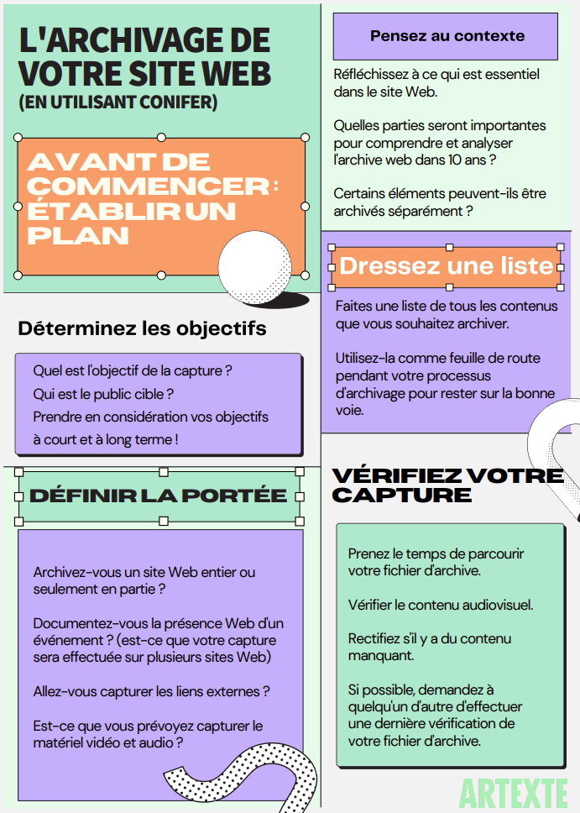
Planification d'un projet d'archivage web
Guide d’une page par Artexte: https://artexte.ca/app/uploads/2021/06/guide_archivage_web.pdf
Notes:
Planning will ensure that you define clearly the limits of the work to be done and for this there are a few steps we want to bring to your attention
On the right of the screen, you can see a one-page document that is available in French and in English from Artexte’s Website, you can use it as a guide to inform the questions that you should be asking yourself.
https://artexte.ca/app/uploads/sites/2/2021/06/web_archiving_guide.pdf
Determine your objectives
What is the purpose of the capture?
Who is the target audience for the archives?
Define the scope of the project and the archiving sessions:
Are you archiving a whole website or only portions?
Will you be archiving across multiple websites to create a collection?
Will you archive external links?
Will you include multimedia elements such as video and audio components? (If not, will these be archived elsewhere?, how do you ensure a link between the documents?)
When planning your project, consider the context of the websites you plan to archive.
For example, who created them and for who?
Does your planned harvesting allow you to give a complete or partial portrait of the content you are capturing?
If you are only capturing portions of a website, perhaps you need to reflect on how you will contextualize of your archival file. For example, will it be necessary to complete the file with additional information to ensure proper interpretation by future users.
Be organized, the tools we will be showing you today involve navigating the page manually, it is easy to lose track of which elements have been archived and which have not.
take the time to list the websites you aim to archive before starting the capture.
the list will help plan objectives for individual harvesting sessions.
and it will be useful during your verifications once the work is complete.

Slide 30
Outil de planification d'archivage web
Notes:
https://tinyurl.com/mryramh7
Excel version (HB share)

Slide 31
À découvrir
Projets / associations
https://www.docnow.io/
https://netpreserve.org/
CUNY LibGuide: https://guides.cuny.edu/digital-toolkit/preservation
Sur la réutilisation d’archives web
https://archivesunleashed.org/about-project/
Outils
https://archiveweb.page/guide
https://github.com/DocNow
https://archive-it.org/
https://artexte.ca/app/uploads/2021/06/guide_archivage_web.pdf
https://netpreserve.org/web-archiving/tools-and-software/

